Slide 1


ABC CALL VOLUME TREND ANALYSIS

Slide 2


PROJECT DESCRIPTION
This project delves into the field of Customer Experience (CX) analytics, focusing on the inbound calling operations of ABC Insurance Company. The goal is to analyze the call volume trends over a 23-day period, determine actionable insights, and propose manpower planning strategies to improve customer satisfaction by reducing the call abandonment rate.

Slide 3

OBJECTIVE
To analyze the average call duration for each time bucket.
To visualize call volumes and identify peak hours.
To propose an optimal manpower plan for reducing the call abandonment rate to 10%.
To include night shift manpower planning for improved customer service.

Slide 4

APPROACH
Data Understanding:
Review raw call data including agent details, queue times, call duration, and call status.
Identify any missing or inconsistent data and clean the dataset.
Data Preparation:
Handle missing values using appropriate imputation techniques.
Transform the dataset to create meaningful time buckets for analysis.
Analysis:
Calculate average call durations for each time bucket.
Visualize call volumes across time buckets to identify trends.
Use call volume data to determine the minimum number of agents required for each time bucket.
Extend manpower planning to include night shift requirements.

Slide 5



TECH-STACK USED
Microsoft Excel (2022): Data cleaning, visualization, and manpower planning calculations.
Canva : Presentation of findings.
Drive : Sharing and Storing Files.

Slide 6

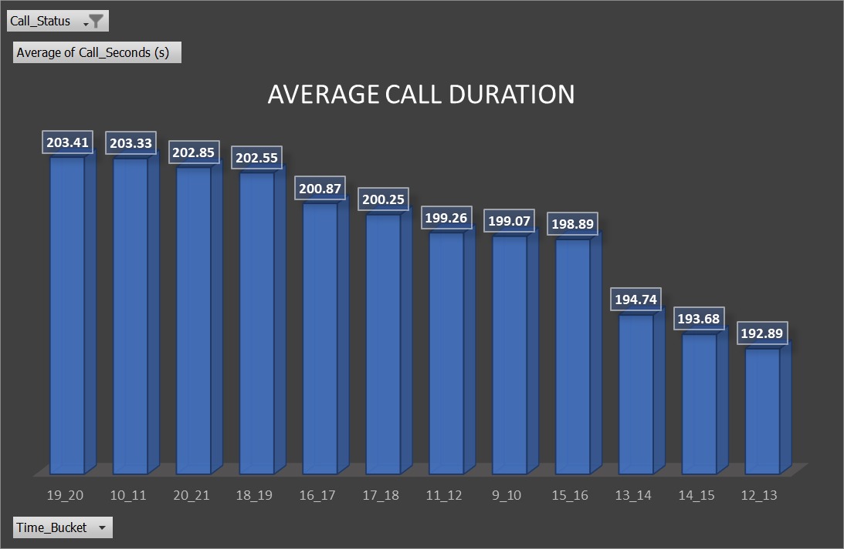
Task 1 : Average Duration of calls

Slide 7

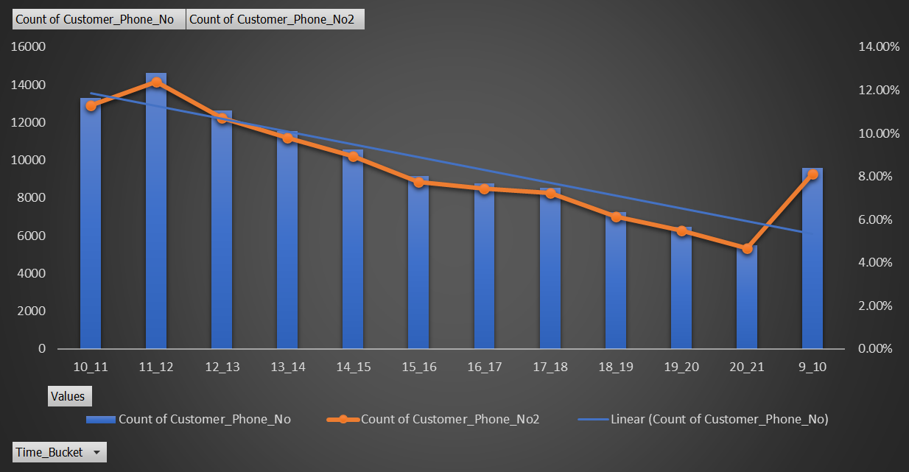
Task 2 : Call Volume Analysis

Slide 8
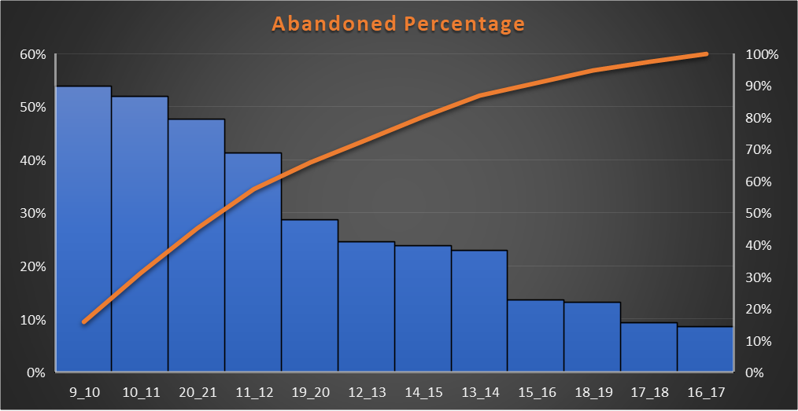
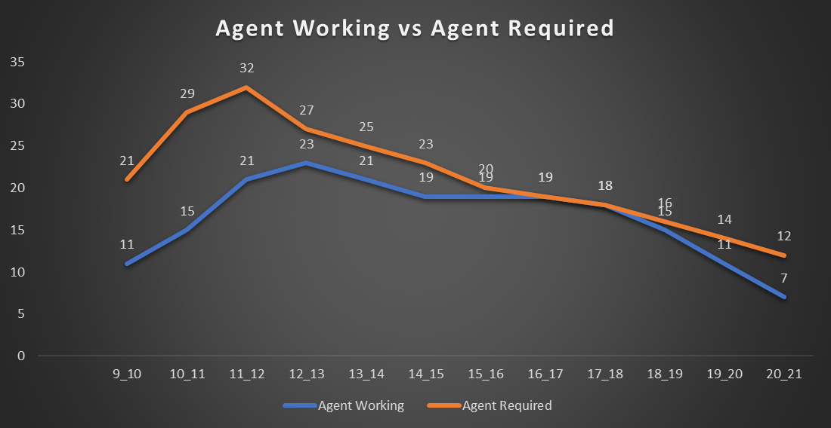
Task 3 : Manpower Planning
Abandoned calls Percentage
Agents Required for Proper functioning

Slide 9
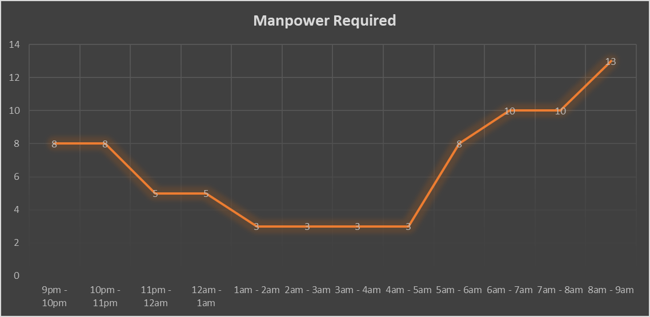
Task 4 : Manpower Planning for Night-Shift

Slide 10

INSIGHTS
Average Call Duration:
The average call duration varied across time buckets, with peak durations occurring in the late morning (10 AM to 12 PM).
Call Volume Trends:
Call volumes peaked during mid-morning (10 AM to 12 PM) and late afternoon (3 PM to 5 PM).
A consistent decline in call volumes was observed after 7 PM.
Day Shift Manpower Planning:
To reduce the abandonment rate to 10%, the required agents per time bucket were calculated. Peak hours required up to 12 agents, while non-peak hours needed fewer agents.
Night Shift Manpower Planning:
For every 100 calls during the day, an additional 30 calls occurred at night. Manpower allocation was proposed for night shifts to maintain a 10% abandonment rate.

Slide 11

RESULTS
Day Shift Manpower Requirements:
A detailed manpower allocation plan was created for each time bucket from 9 AM to 9 PM.
Unplanned leaves and agent productivity were considered to ensure adequate staffing.
Night Shift Plan:
Staffing was recommended for time buckets from 9 PM to 9 AM based on a proportional distribution of night calls.
This included 3-5 agents per time bucket during night hours.
Customer Experience Improvement:
The proposed plan is expected to significantly reduce the call abandonment rate, improving customer satisfaction and loyalty.

Slide 12

DELIVERABLES
📂 Excel Workbook
Includes data cleaning, analysis, and manpower planning.
👉 Click here to access
📊 Report Presentation (PPT, Video presentation)
Summarizes objectives, insights, and recommendations.
Drive link - Click here to access

Slide 13
THANK YOU

